Slide 1
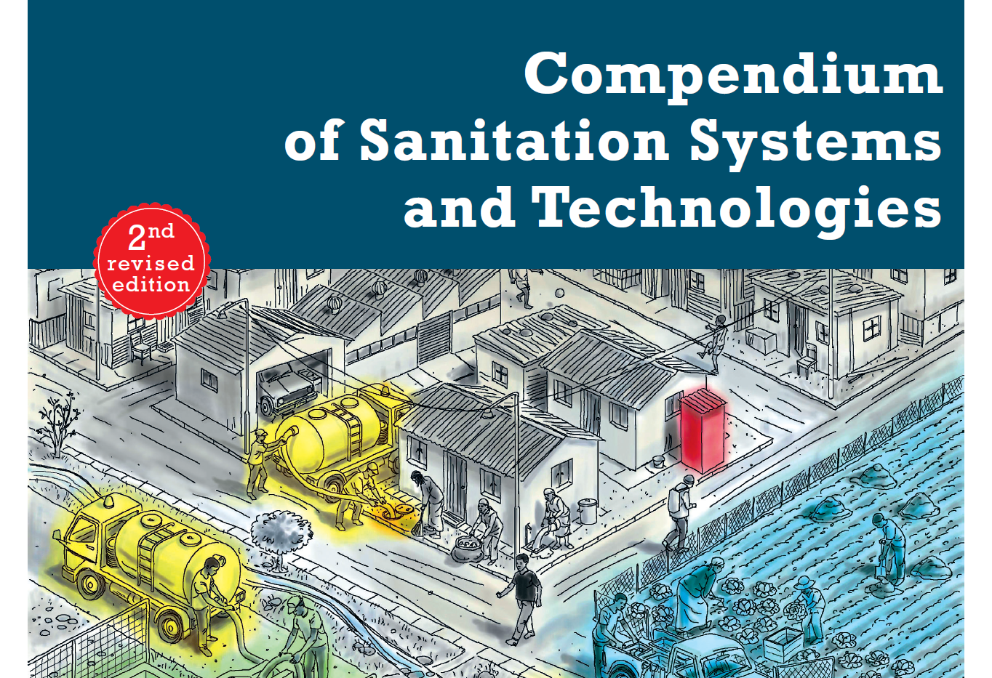

Sanitation System Drawing Tool
Version 1 (July 2015)
Notes:
Version 1 by Dominik Boller and Lukas Ulrich, July 2015

Slide 2
Sanitation System Templates 1-9
The following slides show the nine sanitation system templates from the Compendium. A system template defines a suite of compatible and proven technology combinations from which a sanitation system can be designed. You can easily design your system by editing and modifying one of the templates. For example, remove the technology options that do not apply to your specific context.
System 1: Single Pit System
System 2: Waterless Pit System without Sludge Production
System 3: Pour Flush Pit System without Sludge Production
System 4: Waterless System with Urine Diversion
System 5: Biogas System
System 6: Blackwater Treatment System with Infiltration
System 7: Blackwater Treatment System with Effluent Transport
System 8: Blackwater Transport to (Semi-) Centralized Treatment System
System 9: Sewerage System with Urine Diversion
Edit the system templates by adding or removing elements, changing the position of elements, etc.
☞

Slide 3
System 1: Single Pit System
Dry Cleansing Materials
D.1
Fill and Cover / Arborloo
T.1
T.2
T.3
T.4
T.5
T.6
T.7
T.8
T.9
T.10
T.11
T.12
Settler
Imhoff Tank
ABR
Anaerobic Filter
WSP
Aerated Pond
FWS CW
HSF CW
VF CW
Trickling Filter
UASB
Activated Sludge
Urine
U.1
Dry Toilet
Excreta
S.2
S.3
Single Pit
Single VIP
C.2
C.3
Human-Powered Emptying and Transport
Motorized Emptying and Transport
D.6
D.9
D.10
D.11
Irrigation
Fish Pond
Plant Pond
Disposal / Recharge
Sludge
POST
Filtration / Disinfection
Effluent
U.4
Pour Flush Toilet
Blackwater
Faeces
Anal Cleansing Water
T.13
T.14
T.15
T.16
T.17
Sedimen-tation / Thickening
Unplanted Drying Beds
Planted Drying Beds
Co-Composting
Biogas Reactor
Flushwater
C.7
Transfer Station
Sludge
D.5
D.12
Application
Surface Disposal and Storage
PRE
Pre-Treatment
Greywater
Greywater Treatment
Effluent
D.6
D.7
D.11
Irrigation
Soak Pit
Disposal / Recharge
Stormwater
Stormwater Drains
D.11
Disposal / Recharge

Slide 4
System 2: Waterless Pit System without Sludge Production
Faeces
S.4
S.5
Double VIP
Fossa Alterna
Pit Humus
U.1
Dry Toilet
Excreta
C.2
Human-Powered Emptying and Transport
D.4
Application
Urine
S.8
Composting Chamber
Compost
Organics
Anal Cleansing Water
Dry Cleansing Materials
D.12
Surface Disposal and Storage
Greywater
Greywater Treatment
Effluent
D.6
D.7
D.11
Irrigation
Soak Pit
Disposal / Recharge
Stormwater
Stormwater Drains
D.11
Disposal / Recharge

Slide 5
System 3: Pour Flush Pit System without Sludge Production
Dry Cleansing Materials
D.12
Surface Disposal and Storage
Faeces
Urine
U.4
Pour Flush Toilet
Blackwater
S.6
Twin Pits for Pour Flush
Pit Humus
C.2
Human-Powered Emptying and Transport
D.4
D.12
Application
Surface Disposal and Storage
Flushwater
Anal Cleansing Water
Greywater
Greywater Treatment
Effluent
D.6
D.7
D.11
Irrigation
Soak Pit
Disposal / Recharge
Stormwater
Stormwater Drains
D.11
Disposal / Recharge

Slide 6
System 4: Waterless System with Urine Diversion
Dry Cleansing Materials
D.12
Surface Disposal and Storage
Anal Cleansing Water
Anal Cleansing Water
D.7
Soak Pit
Faeces
Faeces
S.7
Dehydration Vaults
Dried Faeces
C.2
Human-Powered Emptying and Transport
D.3
D.12
Application
Surface Disposal and Storage
U.2
U.3
Urine Diverting Dry Toilet
Urinal
Urine
Urine
S.1
Storage Tank
Stored Urine
C.1
C.3
Jerrycan / Tank
Motorized Emptying and Transport
D.2
Application
Greywater
Greywater Treatment
Effluent
D.6
D.7
D.11
Irrigation
Soak Pit
Disposal / Recharge
Stormwater
Stormwater Drains
D.11
Disposal / Recharge

Slide 7
System 5: Biogas System
Stormwater
Stormwater Drains
D.11
Disposal / Recharge
Greywater
Greywater Treatment
Effluent
D.6
D.7
D.11
Irrigation
Soak Pit
Disposal / Recharge
Organics
Biogas
D.13
Biogas Combustion
Faeces
U.4
Pour Flush Toilet
Blackwater
S.12
Biogas Reactor
Sludge
D.5
D.12
Application
Surface Disposal and Storage
Urine
U.3
U.6
Urinal
Urine Diverting Flush Toilet
Brownwater
Flushwater
Dry Cleansing Materials
Urine
S.1
Storage Tank
Stored Urine
C.1
C.3
Jerrycan / Tank
Motorized Emptying and Transport
D.2
Application
Anal Cleansing Water
D.7
Soak Pit

Slide 8
System 6: Blackwater Treatment System with Infiltration
Stormwater
Stormwater Drains
D.11
Disposal / Recharge
Effluent
D.7
D.8
Soak Pit
Leach Field
Greywater
T.1
T.2
T.3
T.4
T.5
T.6
T.7
T.8
T.9
T.10
T.11
T.12
Settler
Imhoff Tank
ABR
Anaerobic Filter
WSP
Aerated Pond
FWS CW
HSF CW
VF CW
Trickling Filter
UASB
Activated Sludge
Faeces
U.4
U.5
Pour Flush Toilet
Cistern Flush Toilet
S.9
S.10
S.11
Septic Tank
ABR
Anaerobic Filter
D.6
D.9
D.10
D.11
Irrigation
Fish Pond
Plant Pond
Disposal / Recharge
Blackwater
POST
Filtration / Disinfection
Effluent
Urine
C.2
C.3
Human-Powered Emptying and Transport
Motorized Emptying and Transport
Flushwater
Sludge
T.13
T.14
T.15
T.16
T.17
Sedimen-tation / Thickening
Unplanted Drying Beds
Planted Drying Beds
Co-Composting
Biogas Reactor
Anal Cleansing Water
PRE
Pre-Treatment
Sludge
D.5
D.12
Application
Surface Disposal and Storage
C.7
Transfer Station
Dry Cleansing Materials
D.12
Surface Disposal and Storage

Slide 9
System 7: Blackwater Treatment System with Effluent Transport
Stormwater
Stormwater Drains
D.11
Disposal / Recharge
Greywater
T.1
T.2
T.3
T.4
T.5
T.6
T.7
T.8
T.9
T.10
T.11
T.12
Settler
Imhoff Tank
ABR
Anaerobic Filter
WSP
Aerated Pond
FWS CW
HSF CW
VF CW
Trickling Filter
UASB
Activated Sludge
Faeces
U.4
U.5
Pour Flush Toilet
Cistern Flush Toilet
S.9
S.10
S.11
Septic Tank
ABR
Anaerobic Filter
C.4
C.5
Simplified Sewer
Solids-Free Sewer
D.6
D.9
D.10
D.11
Irrigation
Fish Pond
Plant Pond
Disposal / Recharge
Blackwater
Effluent
PRE
Pre-Treatment
POST
Filtration / Disinfection
Effluent
Urine
C.2
C.3
Human-Powered Emptying and Transport
Motorized Emptying and Transport
Flushwater
Sludge
T.13
T.14
T.15
T.16
T.17
Sedimen-tation / Thickening
Unplanted Drying Beds
Planted Drying Beds
Co-Composting
Biogas Reactor
Anal Cleansing Water
PRE
Pre-Treatment
Sludge
D.5
D.12
Application
Surface Disposal and Storage
C.7
Transfer Station
Dry Cleansing Materials
D.12
Surface Disposal and Storage

Slide 10
System 8: Blackwater Transport to (Semi-) Centralized Treatment System
Stormwater
Stormwater Drains
D.11
Disposal / Recharge
Greywater
T.1
T.2
T.3
T.4
T.5
T.6
T.7
T.8
T.9
T.10
T.11
T.12
Settler
Imhoff Tank
ABR
Anaerobic Filter
WSP
Aerated Pond
FWS CW
HSF CW
VF CW
Trickling Filter
UASB
Activated Sludge
Faeces
U.4
U.5
Pour Flush Toilet
Cistern Flush Toilet
D.6
D.9
D.10
D.11
Irrigation
Fish Pond
Plant Pond
Disposal / Recharge
PRE
Pre-Treatment
POST
Filtration / Disinfection
Blackwater
C.4
C.6
Simplified Sewer
Gravity Sewer
Effluent
Urine
Flushwater
T.13
T.14
T.15
T.16
T.17
Sedimen-tation / Thickening
Unplanted Drying Beds
Planted Drying Beds
Co-Composting
Biogas Reactor
Anal Cleansing Water
Sludge
D.5
D.12
Application
Surface Disposal and Storage
Dry Cleansing Materials
D.12
Surface Disposal and Storage

Slide 11
System 9: Sewerage System with Urine Diversion
Stormwater
Stormwater Drains
D.11
Disposal / Recharge
Greywater
T.1
T.2
T.3
T.4
T.5
T.6
T.7
T.8
T.9
T.10
T.11
T.12
Settler
Imhoff Tank
ABR
Anaerobic Filter
WSP
Aerated Pond
FWS CW
HSF CW
VF CW
Trickling Filter
UASB
Activated Sludge
Faeces
U.6
U.3
Urine-Diverting Flush Toilet
Urinal
D.6
D.9
D.10
D.11
Irrigation
Fish Pond
Plant Pond
Disposal / Recharge
PRE
Pre-Treatment
POST
Filtration / Disinfection
Brownwater
C.4
C.6
Simplified Sewer
Gravity Sewer
Effluent
Urine
Flushwater
T.13
T.14
T.15
T.16
T.17
Sedimen-tation / Thickening
Unplanted Drying Beds
Planted Drying Beds
Co-Composting
Biogas Reactor
Anal Cleansing Water
Sludge
D.5
D.12
Application
Surface Disposal and Storage
C.1
C.3
Jerrycan / Tank
Motorized Emptying and Transport
Dry Cleansing Materials
Urine
S.1
Storage Tank
Stored Urine
D.2
Application

Slide 12
How to Use the Sanitation System Drawing Tool
This tool was prepared based on the 2nd edition of the Compendium of Sanitation Systems and Technologies. You can use it to:
Draw your own system by copying / pasting ready-made graphical elements (i.e. products, technologies and arrows, see slides 4-6) to an empty template (slide 3)
Edit and modify systems 1-9 from the Compendium by adding / removing elements, changing the position of elements, etc. (see slides 7-16)
Print your tailor-made system, include it in a report or use the slide in a presentation
Hints
If you use your system in a PowerPoint presentation, you may want to add animations to your elements (e.g. to make them appear in sequence – from User Interface to Use / Disposal).
If you want to edit a technology box (e.g. in systems 1-9), it may be useful to “ungroup” the object first. Right-click the box and select «Group» -> «Ungroup».
Some hints for Windows users:
To duplicate an element, press and hold the Ctrl key while dragging and dropping it with your mouse. Or simply hit Ctrl+D.
You can move an element with your keyboard arrows. For smaller, more precise movements of an element, press and hold the Ctrl key while using the keyboard arrows.
☞
☞
☞
☞

Slide 13
Empty Template (Enter Title)

Slide 14
Products
For the design of a robust sanitation system, it is necessary to define all of the products that are flowing into (inputs) and out of (outputs) each of the sanitation technologies in the system.
Anal Cleansing Water
Dry Cleansing Materials
Pit Humus
Biogas
Effluent
Pre-Treatment Products
Biomass
Excreta
Sludge
Copy / paste the products you need to the input / output columns of your system template.
☞
Blackwater
Faeces
Stored Urine
Brownwater
Flushwater
Stormwater
Compost
Greywater
Urine
Dried Faeces
Organics

Slide 15
Sanitation Technologies
U.1
Dry Toilet
S.1
Storage Tank
C.1
Jerrycan / Tank
T.1
Settler
T.13
Sedimen-tation / Thickening
D.1
Fill and Cover / Arborloo
D.13
Biogas Combustion
Greywater Treatment
U.2
Urine-Diverting Dry Toilet
S.2
Single Pit
C.2
Human-Powered Emptying and Transport
T.2
Imhoff Tank
T.14
Unplanted Drying Beds
D.2
Application
Stormwater Drains
U.3
Urinal
S.3
Single VIP
C.3
Motorized Emptying and Transport
T.3
ABR
T.15
Planted Drying Beds
D.3
Application
U.4
Pour Flush Toilet
S.4
Double VIP
C.4
Simplified Sewer
T.4
Anaerobic Filter
T.16
Co-Composting
D.4
Application
Copy / paste the technologies you need to the corresponding functional group columns of your system template.
The technology codes (e.g. U.1) refer to the technology information sheets in the Compendium.
U.5
Cistern Flush Toilet
S.5
Fossa Alterna
C.5
Solids-Free Sewer
T.5
WSP
T.17
Biogas Reactor
D.5
Application
☞
U.6
Urine-Diverting Flush Toilet
S.6
Twin Pits for Pour Flush
C.6
Conventional Gravity Sewer
T.6
Aerated Pond
D.6
Irrigation
S.7
Dehydration Vaults
C.7
Transfer Station
T.7
FWS CW
D.7
Soak Pit
PRE
POST
Pre-Treatment
S.8
Composting Chamber
T.8
HSF CW
Filtration / Disinfection
D.8
Leach Field
S.9
SepticTank
T.9
VF CW
D.9
Fish Pond
☞
S.10
ABR
T.10
Trickling Filter
D.10
Plant Pond
S.11
Anaerobic Filter
T.11
UASB
D.11
Disposal / Recharge
S.12
Biogas Reactor
T.12
Activated Sludge
D.12
Surface Disposal and Storage

Slide 16
Arrows
Bold arrows are used to show the most appropriate flow path.
Thin arrows indicate alternative flow paths which are possible but not always common or recommended.
Copy / paste arrows to your system template and create the link between products and / or technologies.
To create a link between the source and destination boxes, pull the end / tip of the respective arrow. When you are close to the box, several red dots appear and you can use the appropriate red dot for connecting.
☞
☞

