Slide 1
Waste Survey
Humanitarian Aid Waste Assessment and Improvement Guidelines - HAWAI
T7.1.4 – Training Template
Template for staff training for household and/or non-household waste survey
Information in red: to be adapted to your specific needs and process

Slide 2
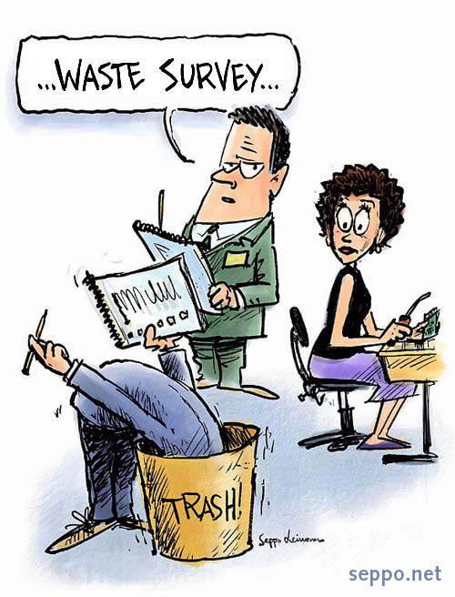
General overview
What is a waste survey? We want to estimate:
  Amounts of waste generated
  Composition of the waste (sometimes)
How we do it?
  Select randomly sampled households and/or non-household waste generators
  Survey for self-reported volumes of waste generated
  And/Or
  Weigh the waste directly at the household and/or non-household waste generators
© Seppo Leinonen

Slide 3
Schedule and process
Randomly selecting participants (households and/or non-households waste generators)
Organizing the team per areas
Surveying households

Slide 4
Randomly selecting households
Each team member will have households assigned to them (ID)
Partitipation of the households is voluntary
If a household refuses to participate, go to the next closest one
Define your prefered option and stick to it for the study
Present the randomly selected households on a map or the randomly selected cells
You can start here to divide also the team and assign household ID to teams or individual staff
If you have a sampling process that diferentiates household type or other clustering method – explain it here
If random sampling through a map and 1 x 1 cm cells –> explain which household to go first: it could be the HH closest to the center of the cell – or in to a given corner – your choice but it has to be consistent for all samples.

Slide 5
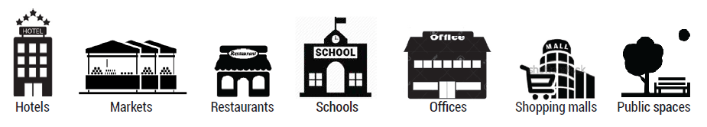
Randomly selecting waste generators
Types of waste generators
Unit of aggregation
Explain what are the types of waste generators that you will sample
Expain the unit of aggregation for each of them – use the survey form for that and the table with each type of waste generator
#stalls
#tables
#students
UN-Habitat, 2021. Waste Wise Cities Tool.

Slide 6
Randomly selecting waste generators
Partitipation is voluntary
When waste generator refuses to participate
  Inform your supervisor to decide which sample to take
Define your prefered option and stick to it for the study

Slide 7
Organising the team per areas
Assign roles and responsibilities – enrolment/collection team & waste characterization team (it can also be the same persons)
Present the areas that will enter the audit on a map and explain how the first day for enrolling the waste generators will be organized
Who will take care of which area / which waste generators
Show the ID list from the reporting sheet
Attribute a team / a person for each waste generator ID, to make sure each have a unique ID
You should also explain how the waste collection will be organized throughout the study

Slide 8
Enrolling the participants
Follow the random sampling instructions
Important to enrol the participants voluntary basis
  Explain the project and the goal
  Ask if willing to answer the survey – it must be an adult
Register GPS location and tag the unique ID and/or report the unique ID and location on a printed map.
Follow the survey questions

Slide 9
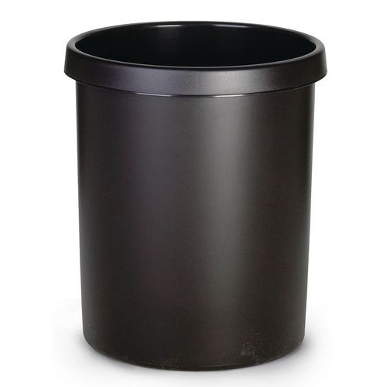
Asking for self-reported generation
Clearly define what you want to measure. Surveyors must explain it to the household. Is it how much waste they give to collection? Does it include the organics that the HH uses themselfs for direct anumal feed or composting? Does it include recyclables that are segregated to be sold?
At households: ask about the # of persons living in the household
  Includes adults and children of all ages
  Ask about people living in the household at the time of the study
At non-households: Ask about the # of units of aggregation
  Very important!
Show the container to the participant an use it as a measure
Ask how much waste they generate per day in average?
  This include all waste they generate, organic, non-organic, etc...
It can be all the container, half, almost full, 1.5 times…
Report the result on the survey form
Define the container each person will use. 30L can be a good option
https://www.witre.fi/fstrz/r/s/www.witre.fi/img/S/GRP/ST/AIG327481.jpg?frz-v=79
30L

Slide 10
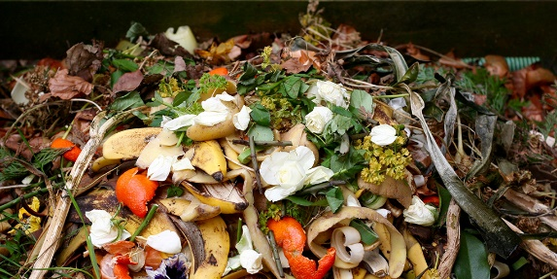
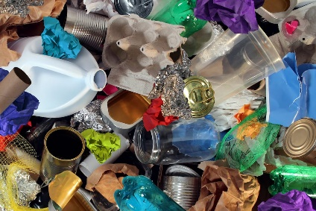
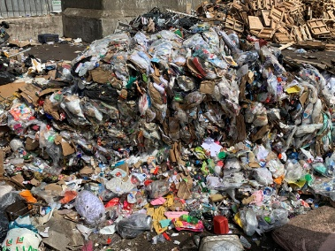
Asking for self-reported generation
Define if you want to ask about different types of waste – keep it simple, it is a difficult task to estimate how much we produce.
You could also have a very specific part if you are interested in a particular material, for example PET
https://www.ccacoalition.org/sites/default/files/resources//food-waste_1024x512.jpg
https://www.rubicon.com/wp-content/uploads/2021/06/what-can-be-recycled.jpg
https://www.letsrecycle.com/wp-content/uploads/2021/07/Residual-waste-2021a.jpg
Organic & green waste
Recyclables
Residual waste
Ask about each fraction and how much they generate, again based on the container
Alternatively, of the total waste reported, how much is of each fraction? In percentage. Household might stuggle with percentage, you can ask to show levels on the container and deduct the percentage yourself
30L
Define what will be asked, all surveyors should ask the same question
Define the container each person will use. 30L can be a good option
https://www.witre.fi/fstrz/r/s/www.witre.fi/img/S/GRP/ST/AIG327481.jpg?frz-v=79

Slide 11
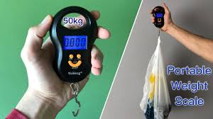

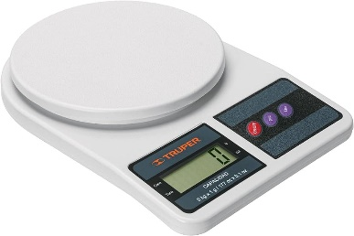
Weighing the waste
At households: ask about the # of persons living in the household
  Includes adults and children of all ages
At non-households: ask about the # of units of aggregation
  Very important!
Ask to put all the waste they have generated in the past days in one or several plastic bags that you provide
  It should only be waste that is regularely generated – not a full cleanup
Ask since when this waste is being generated, when did the participants last disposed of their waste or gave it to collection sevices
  For example: today is Thursday, they mention having given the waste to collection on Monday. So it has been 3 days.
Report the total weigh and number of days
You can weigh the materials per type
https://www.youtube.com/watch?app=desktop&v=7p1urgSRwb8
ID21 – 14.02
Define what you want to measure
https://m.media-amazon.com/images/I/61qTv+xyu2S._AC_UF894,1000_QL80_.jpg

Slide 12
Waste types
You will probably only use fewer categories in a waste survey. Please select the ones that you are surveying or make group them.
Organics: organic waste & kitchen/park waste
Recyclable: often -> paper/cardboard, plastics (some), metals, glass
Residues: all the rest
Organic Food/Kitchen Waste | Rests of food, coocked or uncoocked, organic rests from food preparation
Organic Garden/Wood Waste | Branches, leaves
Paper and cardboard | Packaging or products made of paper or cardboard
Plastics | All types of plastics, containers, wrapping, bags
Metals | Tin or aluminium cans, aluminium wrapping, other metal objects
Glass | Bottles, jars, glasses,
Textiles and shoes | Clothes and other textiles products, shoes
Wood | Processed wood (treated or untreated)
Special wastes | Electric and electronics, batteries, light bulbs, cables, other hazardous waste
Composite products | Products made of a combination of materials, tetrapack for example
Other | Everything that does not fit the above categories, inerts, sanitary waste, rubber
If you want to measure waste types, be clear with the staff what each type that you measure includes.
This must also be comunicated to the households when requesting for self-reporting

Slide 13
UN-Habitat, 2021. Waste Wise Cities Tool.
Organic Food/Kitchen Waste
Organic Garden/Wood
Waste
Paper and cardboard
Plastics
Metals
Glass
Textiles and shoes
Wood
Special wastes
Composite products

Slide 14
Risks
Content of waste bags can include dangerous items
What items could be dangerous and why?

Slide 15
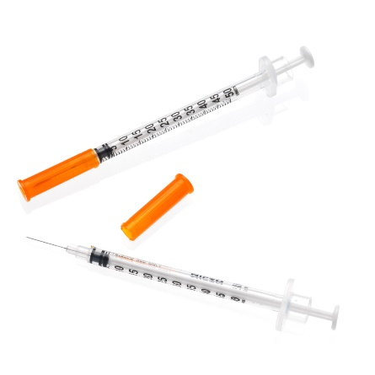

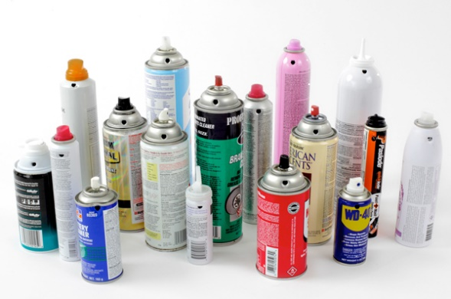
Risks
https://didactic.care/photos/SERI3P05AS2913.jpg
https://www.jatai.net/wp-content/uploads/2017/02/Feather-Double-Edge-Blade-760x639.jpg
Sharp items can cut or puncture
  Blades, Glass, Metal, Syringe needles
Hazardous waste can intoxicate or cause fire
  Paints, Aerosols
Biohazard can make you sick
  Diapers, Toilet paper, Sanitary waste
  Syringe needles
Contaminated materials
  Dust, all items in contact with mixed waste
https://www.franceenvironnement.com/image-produit/57291/T2/197095729135ab15009cc0b09c6e2b7f0fb14f8b0759706e63add23.jpg
Content can sometimes be unexpected!

Slide 16
Safety and use of PPE
In the case of needing to weigh waste
Waste bags:
  Always consider that content is unknown and manipulate with care
  Sharp items could hurt you or your collegues
  Hold the bags from the top and do not squeeze or push them with your hands, even with gloves
Waste manipulation
  Never plunge your hands into the waste, use tools if you need to do so
  Keep in mind that dangerous items could be present
Hygiene:
  Wash hands with soap regularely and use disinfectant
  Eat and drink after washing hands and face
Use gloves

Slide 17
Let’s do this waste survey!

