Slide 1
Waste Audit Humanitarian Aid Solid Waste Assessment and Improvement Guidelines - HAWAI
T7.2.4 – Training Template
Template for staff training for household and/or non-household waste audit – adapt accordingly
Information in red: to be adapted to your specific needs and process

Slide 2
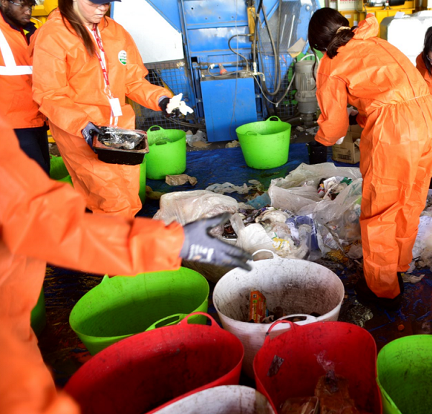
General overview
What is a waste audit? We want to measure:
Amounts of waste generated
Composition of the waste
How we do it?
Randomly sampled waste generators
Select min. 96 randomly sampled households
Collect their waste during a full week
Weigh and separate the waste per categories
https://www.cleanaway.com.au/about-us/our-customers/waste-health-check/

Slide 3
Schedule and process
Randomly selecting waste generators (households and/or non-household)
Organizing the team per areas
Enrolling households
Distributing and collecting waste bags
Waste sorting and characterization

Slide 4
Randomly selecting households
Partitipation of the households is voluntary
If a household refuses to participate, go to the next closest one
Define your prefered option and stick to it for the study
Present the randomly selected households on a map or the randomly selected cells
You can start here to divide also the team and assign household ID to teams or individual staff
If you have a sampling process that diferentiates household type or other clustering method – explain it here
If random sampling through a map and 1 x 1 cm cells –> explain which household to go first: it could be the HH closest to the center of the cell – or in to a given corner – your choice but it has to be consistent for all samples.

Slide 5
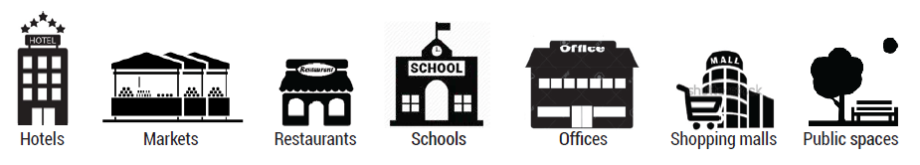
Randomly selecting waste generators
Types of waste generators
Unit of aggregation
Explain what are the types of waste generators that you will sample
Expain the unit of aggregation for each of them
#stalls
#tables
#students
UN-Habitat, 2021. Waste Wise Cities Tool.

Slide 6
Randomly selecting waste generators
Partitipation is voluntary
When waste generator refuses to participate
Inform your supervisor to decide which sample to take
Define your prefered option and stick to it for the study
Present the randomly selected waste generators on a map or the randomly selected cells
You can start here to divide also the team and assign generators ID to teams or individual staff
If random sampling through a map and 1 x 1 cm cells –> explain how to select the waste generator – your choice but it has to be consistent for all samples.

Slide 7
Organising the team per areas
Assign roles and responsibilities – enrolment/collection team & waste characterization team (it can also be the same persons)
Present the areas that will enter the audit on a map and explain how the first day for enrolling the waste generators will be organized
Who will take care of which area / which households
Show the waste generator ID list from the reporting sheet
Attribute a team / a person for each waste generator ID, to make sure each HH and/or non-HH have a unique ID
You should also explain how the waste collection will be organized throughout the study

Slide 8
Schedule
Present the daily schedule and dates that you have planned for the study
Day | Team | Waste generator
Day 1 | Enrol the waste generator in the study – ask for informed consent Register the number of units of aggregation Distribute labelled bag n°1 | Use bag n°1 to dispose all waste from day 1
Day 2 | Collect bag n°1 Distribute labelled bag n°2 Discard bag n°1 – do not weigh or perform composition study | Hand over bag°1 Use bag n°2 to dispose all waste from day 2
Day 3 | Collect bag n°2 Distribute labelled bag n°3 Weigh each bag of day 2 and report the weight Measure sample composition of day 2 | Hand over bag°2 Use bag n°3 to dispose all waste from day 3
Day 4 | Collect bag n°3 Distribute labelled bag n°4 Weigh each bag of day 3 and report the weight Measure sample composition of day 3 and report the results | Hand over bag°3 Use bag n°4 to dispose all waste from day 4
Day 5 | Collect bag n°4 Distribute labelled bag n°5 Weigh each bag of day 4 and report the weight Measure sample composition of day 4 and report the results | Hand over bag°4 Use bag n°5 to dispose all waste from day 5
Day 6 | Collect bag n°5 Distribute labelled bag n°6 Weigh each bag of day 5 and report the weight Measure sample composition of day 5 and report the results | Hand over bag°5 Use bag n°6 to dispose all waste from day 6
Day 7 | Collect bag n°6 Distribute labelled bag n°7 Weigh each bag of day 6 and report the weight Measure sample composition of day 6 and report the results | Hand over bag°6 Use bag n°7 to dispose all waste from day 7
Day 8 | Collect bag n°7 Distribute labelled bag n°8 Weigh each bag of day 7 and report the weight Measure sample composition of day 7 and report the results | Hand over bag°7 Use bag n°8 to dispose all waste from day 8
Day 9 | Collect bag n°8 Give compensation (if applies) Weigh each bag of day 8 and report the weight Measure sample composition of day 8 and report the results | Hand over bag°8

Slide 9
Enrolling waste generators
Follow the random sampling instructions
Important to enrol the household on a voluntary basis
Explain the project and the goal
Explain the role of the household
Explain that their waste is anonymised
Formally enrol through the informed consent letter or oral consent
Hand in information sheet & first bag
Register GPS location and tag the household ID and/or report the HH ID and location on a printed map.
Use the sticker with the HH ID for identification
Ask about the # of persons living in the household
Includes adults and children of all ages
Ask about people living in the household at the time of the study
Ask about the # of units of aggregation for the given type of waste generator (non-household)
What process did you decide to do? Adapt accordingly

Slide 10
Large non-household waste generators
Audit on site if possible – a team is directly weighing and measuring composition at the waste generator location
Coordination with managers and waste handlers needed

Slide 11
Distributing and collecting waste bags
This information depends on your defined schedule, each day collection or skip a day? Adapt accordingly
Each day collect the bags from previous day(s) even if no waste was generated – check that the bag tag is still readable
Hand in a new bag – make sure the bag is properly tagged
Make an effort to write readable and understandable numbers
Use permanent markers directly on the bags and/or on a tag/sticker
Report on your waste generator list which bags you have collected
Note any reason for not having collected a bag
Nobody present
The bag was inadvertently given to the normal waste collection
Any other reason….
Bag tag
ID – date
Example: ID21 – 14.02
Important to have for data analysis

Slide 12


Waste characterization
Waste of day 1 will not be characterized – but never tell this to the waste generators. Accumulated waste from previous days might be present and this is why we discard day 1.
Weighing all the bags each subsequent day and reporting the weight
ID of the bag indispensable! -> a bag has to be linked to a waste generator
ID21 – 14.02
Report the weight for day 14.02 for waste generator #21

Slide 13
Waste sorting and characterization
At the sorting site:
Weigh all the bags
Open all bags and separate per material type
Separate as far as possible – for example if organics inside of a plastic bag
Plastic bag to plastics
Organic content to organics
Liquids can be weighed separately from their container
Hazardous wastes: keep in original container
Ask if unsure
https://www.cleanaway.com.au/about-us/our-customers/waste-health-check/

Slide 14
Waste characterization
In some cases, the quartering method will be used
Start on a clean large plastic sheet, open and empty all the waste bags on it
Use tools (rake, shovel) to thoroughly mix all the waste until it is homogeneously mixed
Spread the waste on the plastic sheet so that it forms a flat layer
Divide the waste into 4 quarters of the same sizes: A, B, C and D.
Discard two diagonally opposed fractions, for example A & C
Combine and mix the two other diagonally opposed fractions, B & D
Repeat this quartering method until the combined remaining weigh is about 50-70 kg
Measure the composition of this remaining 50-70 kg by separating the waste and weighing the individual fractions
UN-Habitat, 2021. Waste Wise Cities Tool.
You will decide if you go for the quartering method when you actually see the waste
At that moment, you can judge if the quartering methods is appropriate and possible to do
For non-household waste generators – one measure should be done for each type of waste generator

Slide 15
Waste characterization
Organic Food/Kitchen Waste | Rests of food, coocked or uncoocked, organic rests from food preparation
Organic Garden/Wood Waste | Branches, leaves
Paper and cardboard | Packaging or products made of paper or cardboard
Plastics | All types of plastics, containers, wrapping, bags
Metals | Tin or aluminium cans, aluminium wrapping, other metal objects
Glass | Bottles, jars, glasses,
Textiles and shoes | Clothes and other textiles products, shoes
Wood | Processed wood (treated or untreated)
Special wastes | Electric and electronics, batteries, light bulbs, cables, other hazardous waste
Composite products | Products made of a combination of materials, tetrapack for example
Other | Everything that does not fit the above categories, inerts, sanitary waste, rubber
Describe according to your waste types list

Slide 16
UN-Habitat, 2021. Waste Wise Cities Tool.
Organic Food/Kitchen Waste
Organic Garden/Wood
Waste
Paper and cardboard
Plastics
Metals
Glass
Textiles and shoes
Wood
Special wastes
Composite products

Slide 17
Risks
Content of waste bags can include dangerous items
What items could be dangerous and why?

Slide 18
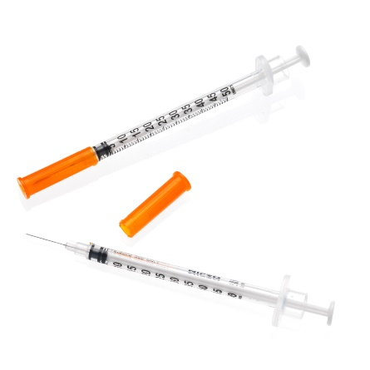

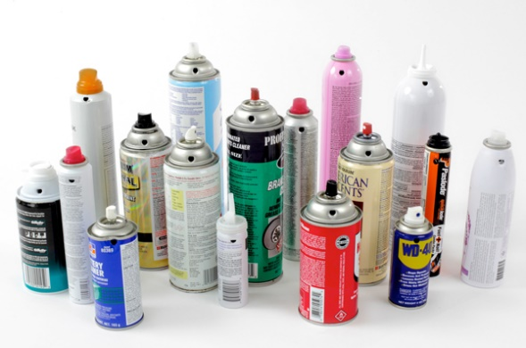
Risks
https://didactic.care/photos/SERI3P05AS2913.jpg
https://www.jatai.net/wp-content/uploads/2017/02/Feather-Double-Edge-Blade-760x639.jpg
Sharp items can cut or puncture
Blades, Glass, Metal, Syringe needles
Hazardous waste can intoxicate or cause fire
Paints, Aerosols
Biohazard can make you sick
Diapers, Toilet paper, Sanitary waste
Syringe needles
Contaminated materials
Dust, all items in contact with mixed waste
https://www.franceenvironnement.com/image-produit/57291/T2/197095729135ab15009cc0b09c6e2b7f0fb14f8b0759706e63add23.jpg
Content can sometimes be unexpected!

Slide 19
Safety and use of PPE
Waste bags:
Always consider that content is unknown and manipulate with care
Sharp items could hurt you or your collegues
Hold the bags from the top and do not squeeze or push them with your hands, even with gloves
Waste manipulation
Never plunge your hands into the waste, use tools if you need to do so
Keep in mind that dangerous items could be present, and be small and difficult to see
With your hands, pick waste items that you can see and identify only
Informe supervisor and collegues if you see hazardous and dangerous items
Hygiene:
Wash hands with soap and use disinfectant
Do not touch your face of skin with your working gloves or without washing your hands – gloves are contaminated!
Eat and drink after washing hands and face – aside from the waste

Slide 20
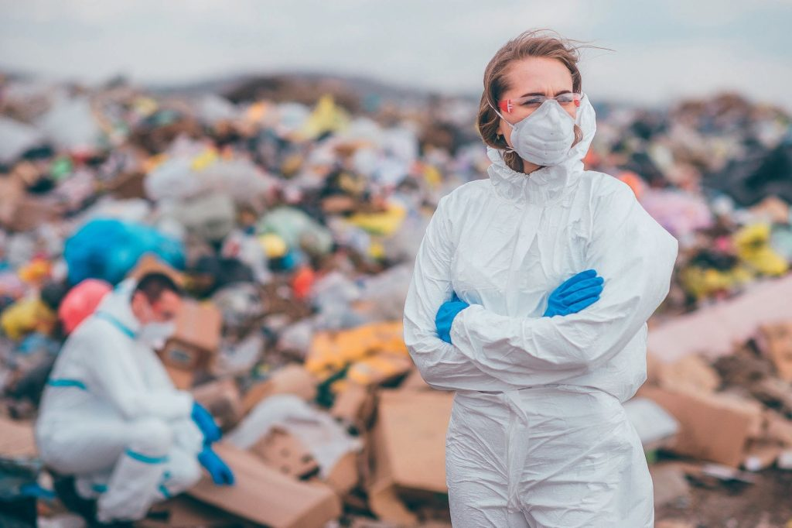
Safety and use of PPE
Protective goggles
Hat or cap to protect from the sun and dust
Face masks
Boots – water resistant
(rubber boots for example or work appropriate footwear)
Thick gloves – water resistant
https://cdn.ca.emap.com/wp-content/uploads/sites/6/2023/05/No-room-for-complacency-1024x682.jpg
Long sleeves and long pants clothing // overall

Slide 21
Info. and instructions to waste generators
General objectives of the process, collection schedule, instructions and informed consent
That all information gathered is handled confidentially
Do not use the normal waste collection service and don’t self-manage your waste (burning, or dumping)
Gather the waste generated each day and dispose it in the corresponding dated bag(s)
Store it until the team comes to collect it (according to the schedule) That they will receive new bags (according to the schedule)
If relevant: specific instructions in case of use of organics or recyclables (for example, to keep using them normally, that they will be measured each day at the door or not measured)
In case nobody is home when waste is meant to be collected (deposit waste in a safe spot and indicate how you will hand in the new bag for the following day)
Inform all family members of the process – to avoid confusions within the household
Inform all relevant persons of the process – to avoid confusions
It can be the persons responsible for waste management, collegues, teachers, etc…
For needles and sharps, if possible hand them in separately (applies only if needles are expected to be largely generated at household level)
If any question – use the contact information to communicate with the study team
Change according to your process
Decide if this is relevant
Provided in the instructions sheet

Slide 22
Let’s do this waste audit!

