Slide 1
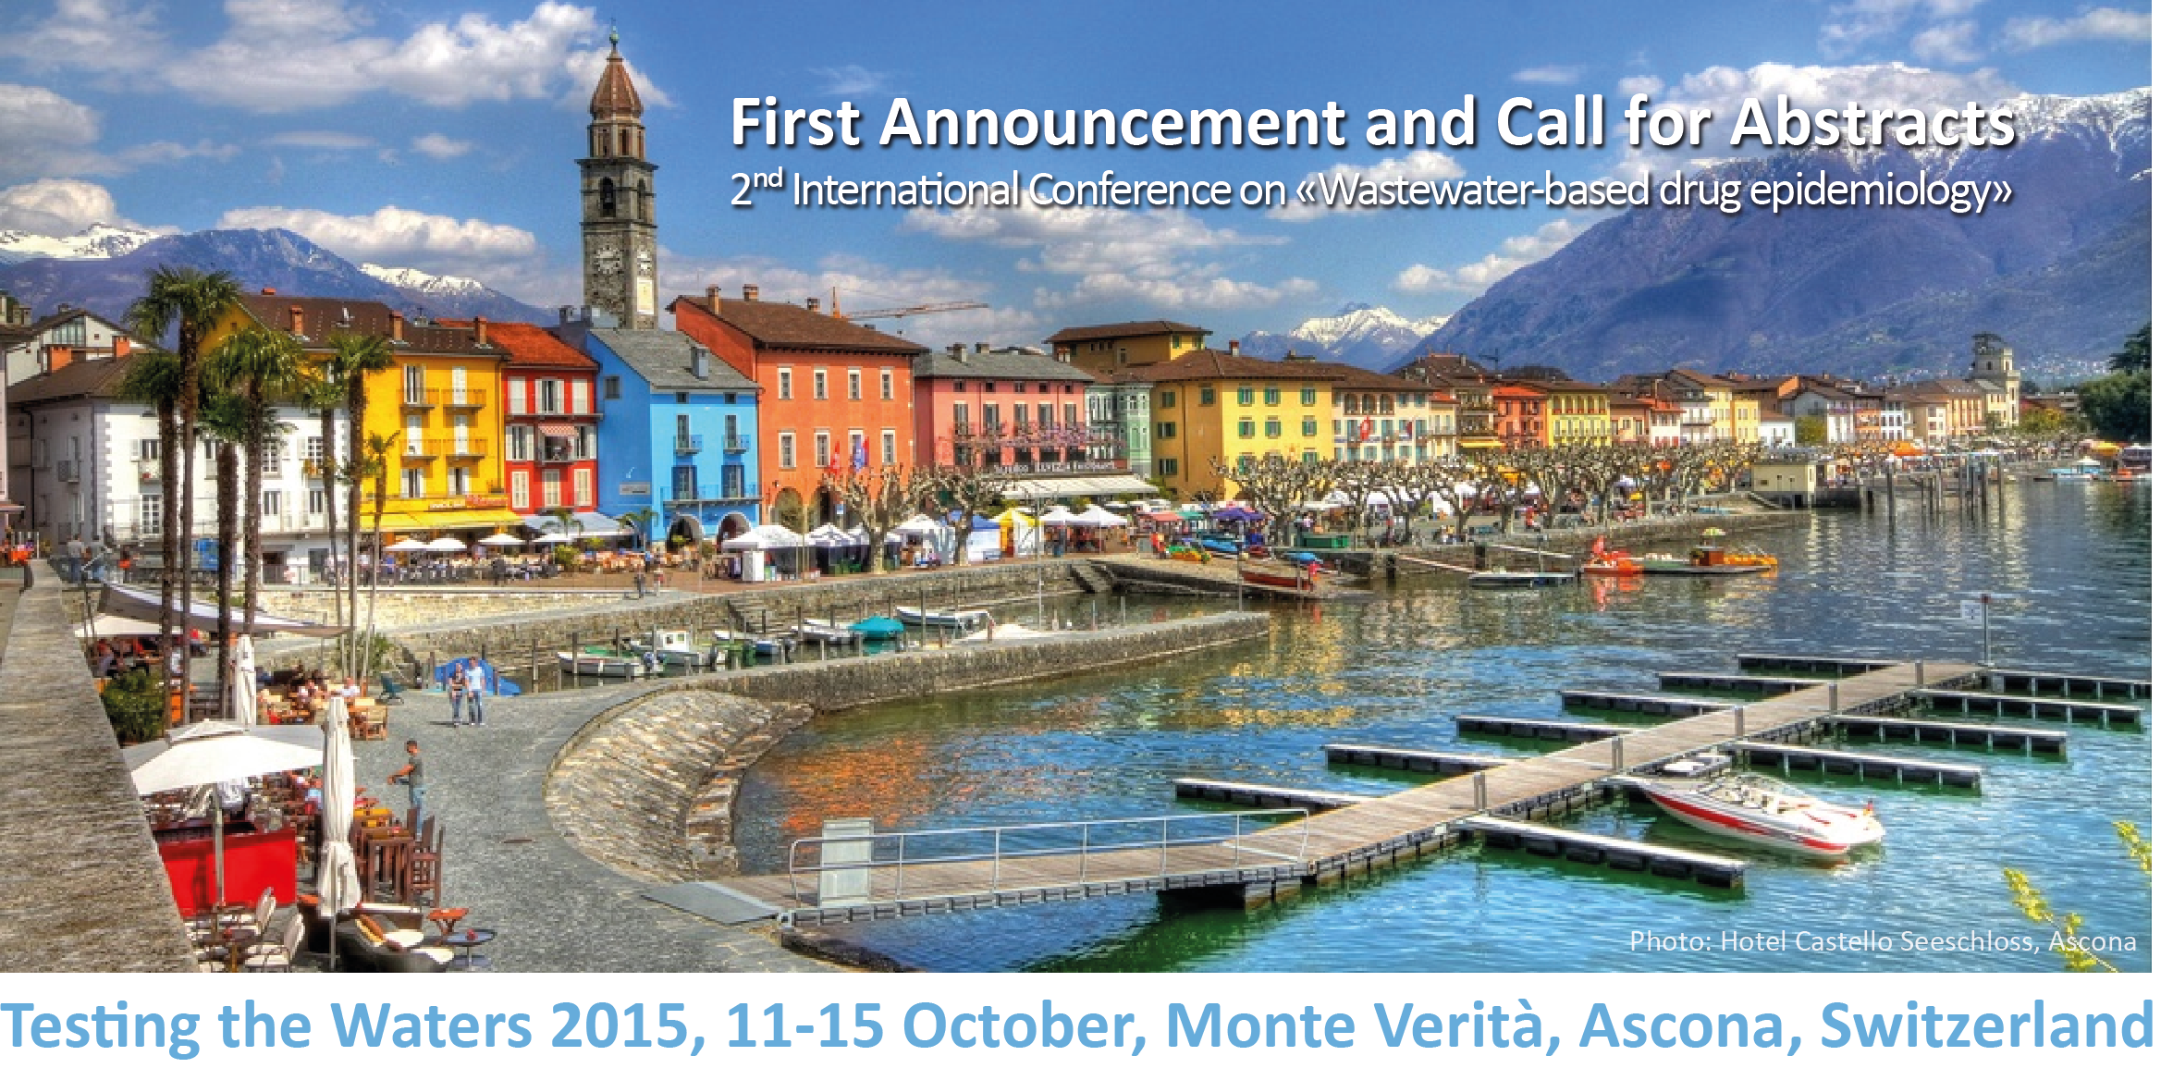







Slide 2
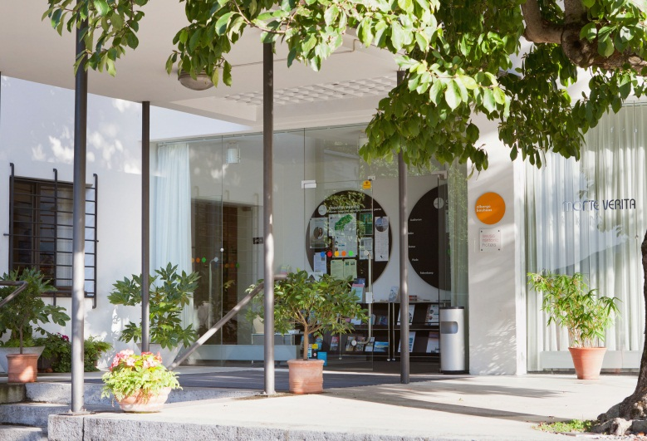
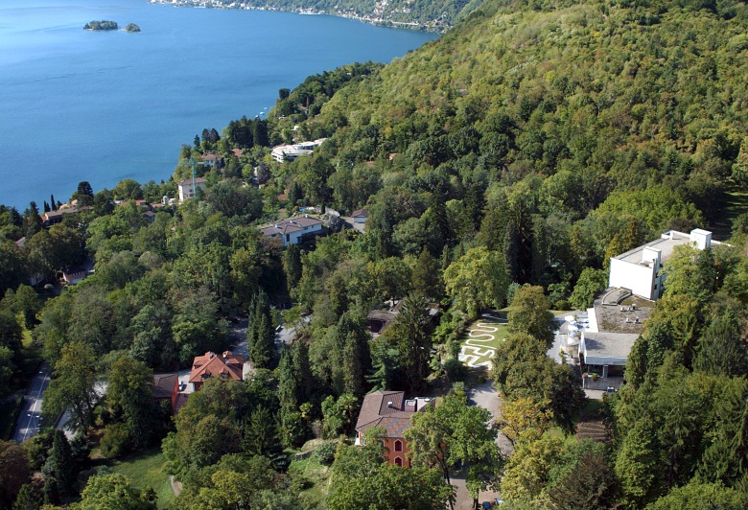
Conference Themes emphasizing trans-disciplinarity
Monitoring Studies targeted sampling at local, regional, national and international scale, preferably integrating wastewater results with other epidemiological data.
Methodological Improvements quantifying and reducing uncertainty of back-calculation, monitoring design and in-sewer transformation.
Advances in Analytical Chemistry method refinements and ability to measure new substances.
Ethical and Legal Aspects discussion of settings requiring special attention.
Innovative Applications wastewater analysis for community-wide health assessment beyond illicit drugs.

Slide 3
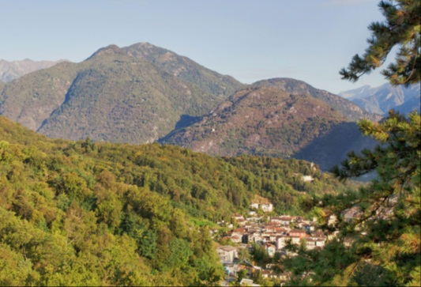
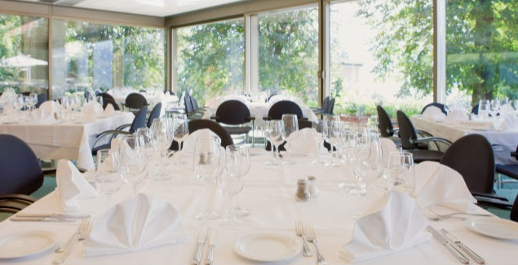
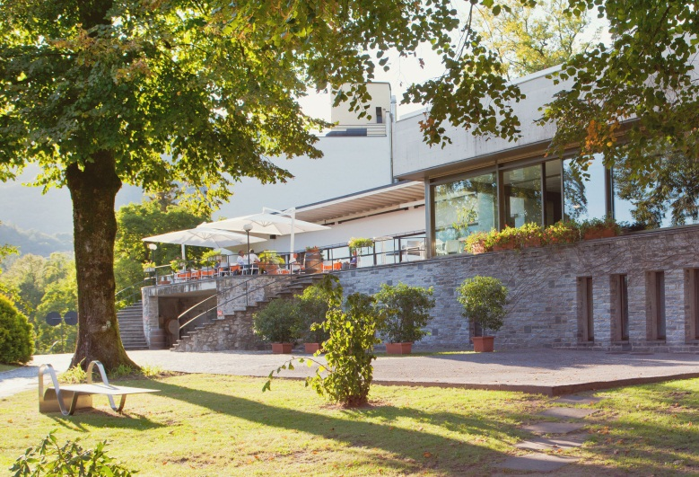
General information
Keynote speakers
Caleb Banta-Green University of Washington, US
Jørgen G Bramness Centre for Addiction Research, NO
Wayne Hall The University of Queensland, AU
Matthew Hickman University of Bristol, UK
Dirk Korf University of Amsterdam, NL
Jochen F Mueller The University of Queensland, AU
Thomas Pietschmann UNODC, AT
Alain Verstraete Ghent University, BE
Adam R Winstock Kings College London, UK
Key dates
24 April 2015 deadline for abstracts
26 June 2015 final programme
11-15 October 2015 conference
Venue
Monte Verità, Ascona
Switzerland conference centre and hotel

Slide 4
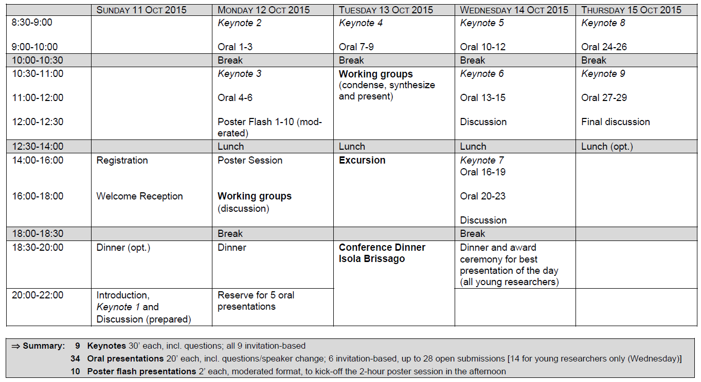
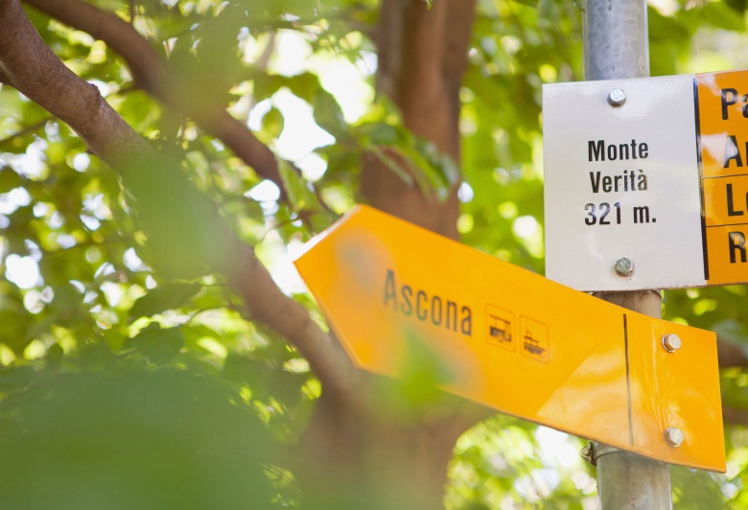
Tentative programme and contact
testingthewaters2015@demariaevent.ch
www.testingthewasters2015.ch

Slide 5
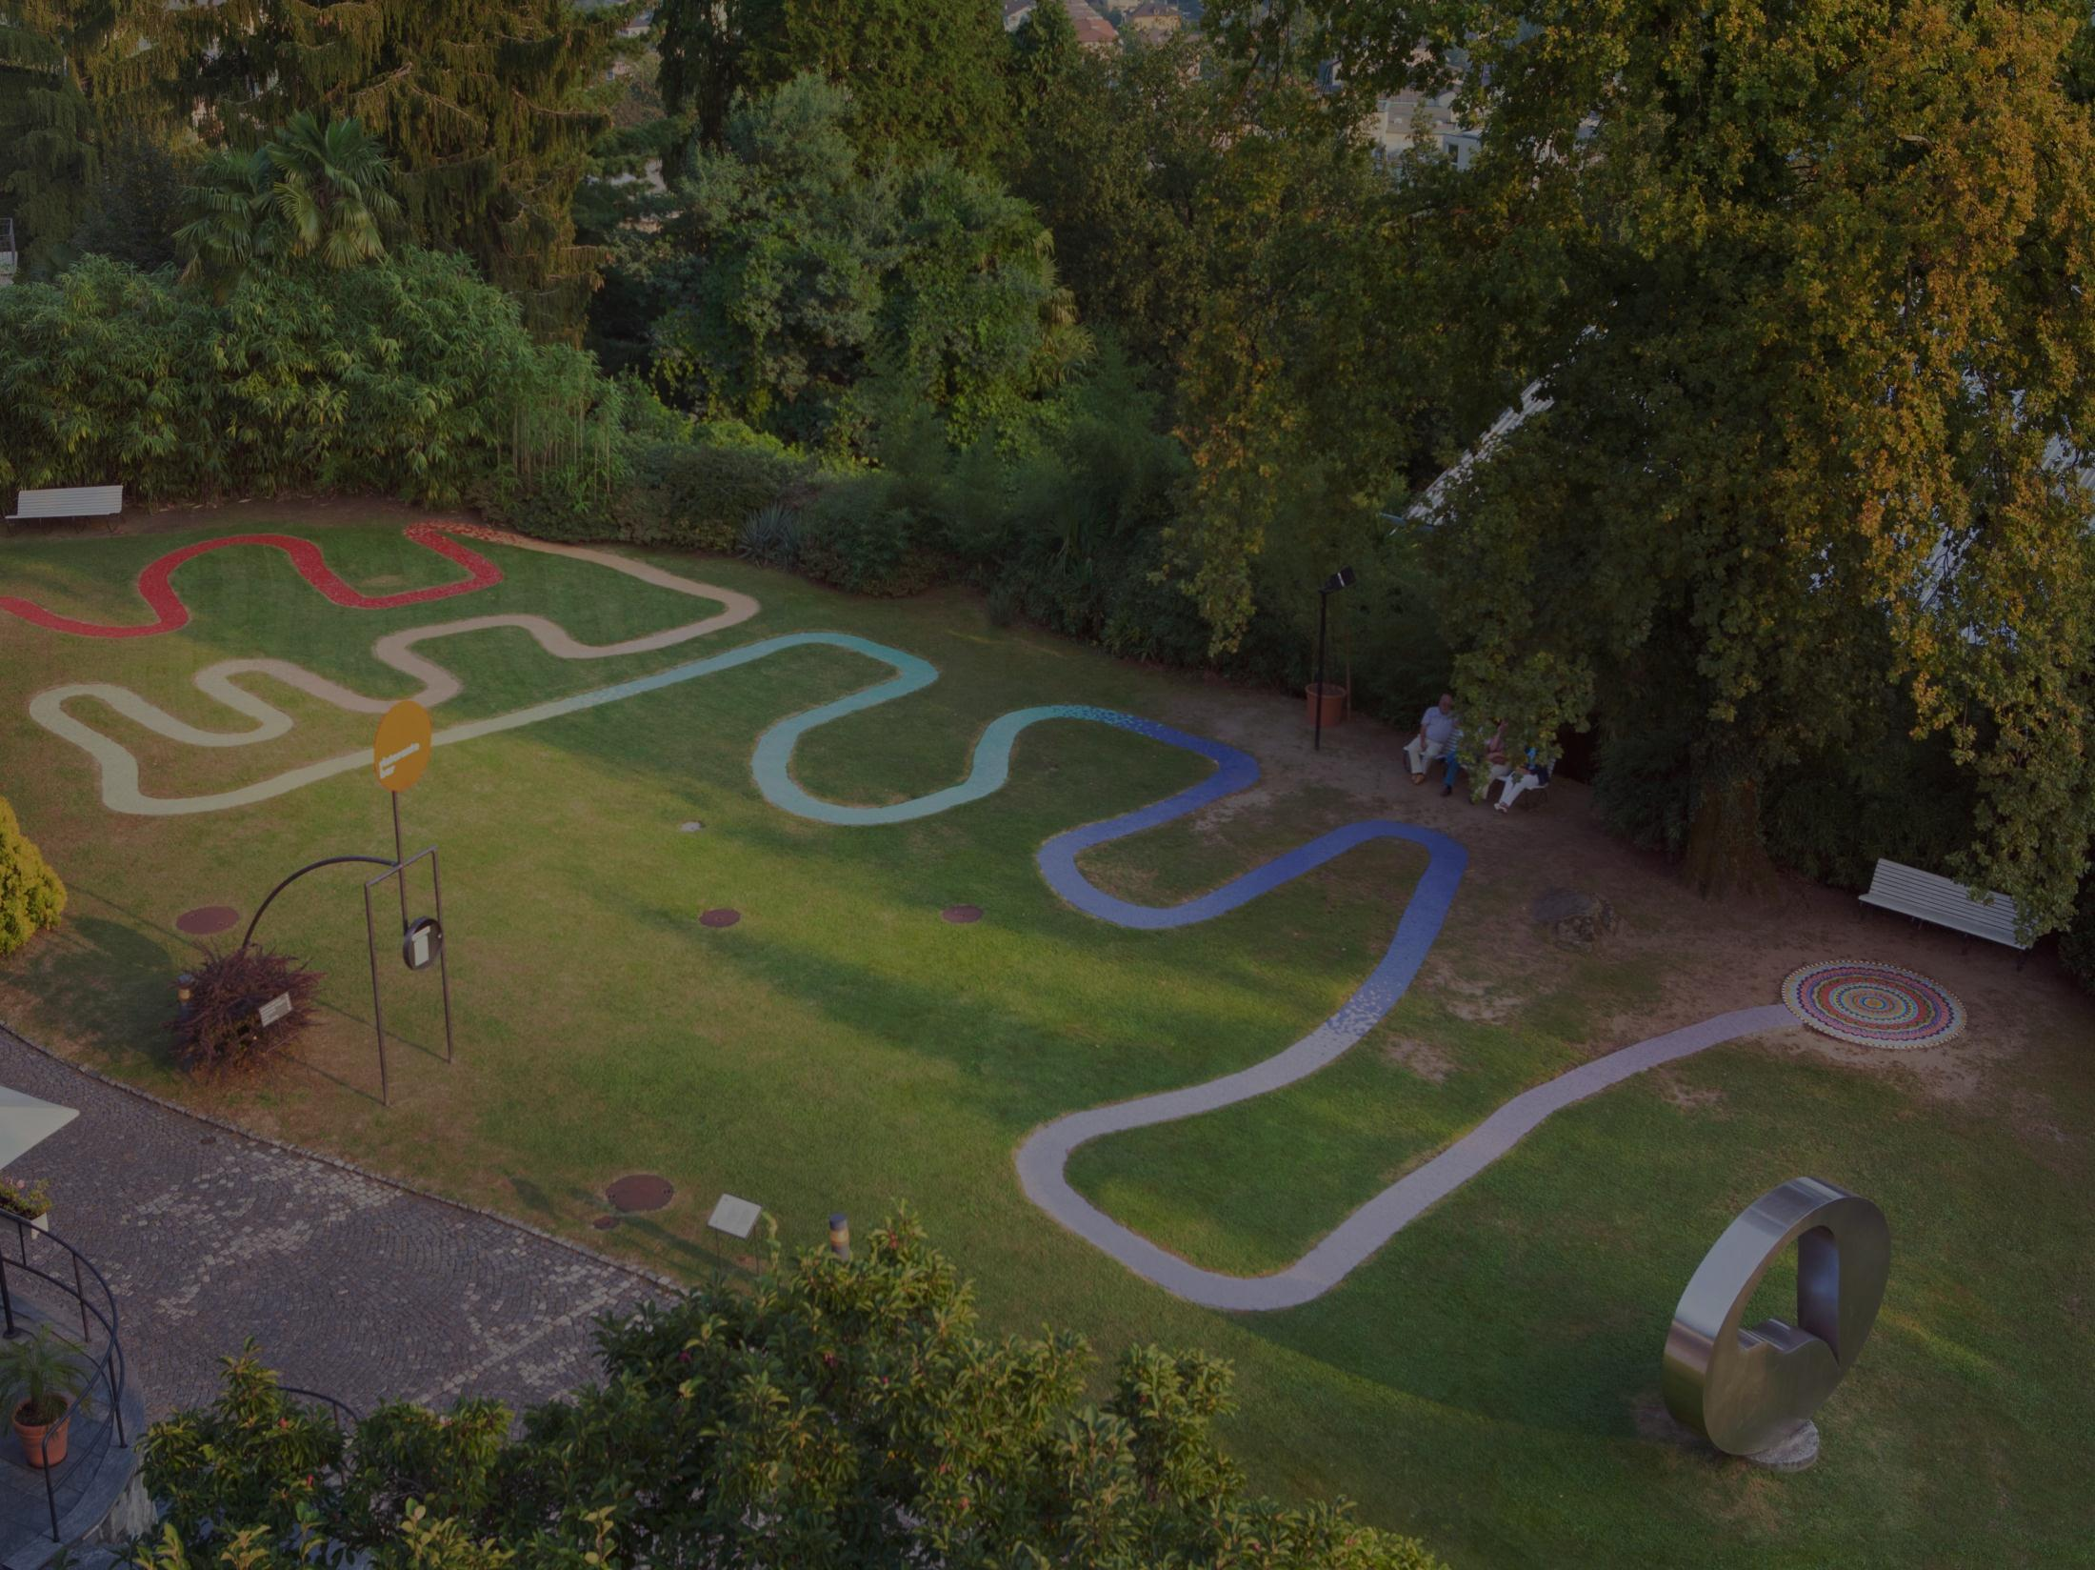
We are looking forward to welcoming you!
Scientific committee Ellen Amundsen SIRUS, Norway; Caleb Banta-Green University of Washington, USA; Frédéric Béen UNIL, Switzerland; Lubertus Bijlsma University Jaume I, Spain; Sara Castiglioni Mario Negri, Italy; Adrian Covaci University of Antwerp, Belgium; Pim de Voogt KWR/University of Amsterdam, the Netherlands; Erik Emke KWR, the Netherlands; Pierre Esseiva UNIL, Switzerland; Paul Griffiths EMCDDA, Portugal; Félix Hernández University Jaume I, Spain; Barbara Kasprzyk-Hordern University of Bath, UK; Angela Me UNODC, Austria; Malcolm Reid NIVA, Norway; Christoph Ort (conference chair) Eawag, Switzerland; Jeremy Prichard University of Tasmania, Australia; Justice Tettey UNODC, Austria; Kevin Thomas NIVA, Norway; Liesbeth Vandam EMCDDA, Portugal; Guido Van Hal, Alexander van Nuijs University of Antwerp, Belgium; Ettore Zuccato Mario Negri, Italy.
Organizing committee Sara Castiglioni Mario Negri, Italy; Paolo Demaria DEM, Switzerland; Paul Griffiths EMCDDA, Portugal; Barbara Kasprzyk-Hordern University of Bath, UK; Max Maurer ETH, Switzerland; Christoph Ort Eawag, Switzerland; Kevin Thomas NIVA, Norway.
www.testingthewasters2015.ch

